Slide 1

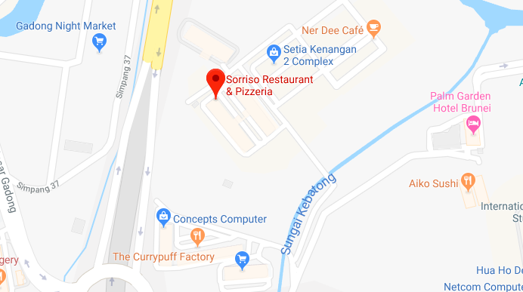








- 1 HR +
Starts
1:20PM
Ends Today
2:20PM
$ $1.00
Select Parking Lot Location
Select Vehicle
Select Card
PROCEED
Notes:
w
<div id = “header”></div>
<img />
<div id = “form”>
<div id = “time-selector”></div>
<div id= “time-range”>
<div id = “start-time” class = “time-boundary”></div>
<div id = “end-time” class = “time-boundary”></div>
</div>
<div id= “total-cost” class = “form-row”></div>
<div id= “lot-selector” class = “form-row”></div>
<div id= “vehicle-selector” class = “form-row”></div>
<div id= “card-selector” class = “form-row”></div>
<button></button>
</div>
<nav id = “nav-bar”>
<a href = ” “></a>
<a href = “ “></a>
<a href = “ “></a>
<a href = “ “></a>
</nav>

Slide 2

SELECT CAR PARK
Search Car Park
Nearest Car Park
Name of of car park
Name of of car park
Name of of car park
Name of of car park
Name of of car park
Name of of car park
All Car Parks
Name of of car park
Name of of car park
Name of of car park
Name of of car park
Name of of car park
Name of of car park
Notes:
<div id = “header”></div>
<div id = “main-title”>
<img / >
</div>
<div id = “search-lot”>
<input></input>
<img / >
</div>
<div id = “nearest-lots”>
<h1> Nearest Car Park</h1>
<div class = “lot”>..</div>
<div class = “lot”>..</div>
<div class = “lot”>..</div>
<div class = “lot”>..</div>
<div class = “lot”>..</div>
</div>
<div id = “all-lots”>
<div class = “lot”>..</div>
<div class = “lot”>..</div>
<div class = “lot”>..</div>
<div class = “lot”>..</div>
<div class = “lot”>..</div>
</div>
<nav id = “nav-bar”>
<a href = ” “></a>
<a href = “ “></a>
<a href = “ “></a>
<a href = “ “></a>
</nav>

Slide 3



ADD VEHICLE
Enter Vehicle Registration Number
Car
Truck
Motorcycle
SAVED VEHICLE(S)
KK 3605
BN 4490
ADD VEHICLE
Notes:
<div id = “header”></div>
<div id = “main-title”>
<h1> ADD VEHICLE </h1>
<img / >
</div>
<div id = “reg-num” >
<input></input>
</div>
<div id = “vehicle-types”>
<div class = “vehicle-type”>
<img />
Car
</div>
<div class = “vehicle-type”>
<img />
Truck
</div>
<div class = “vehicle-type”>
<img />
Motorcycle
</div>
</div>
<h1> SAVED VEHICLE(S) </h1>
<div id = “saved-vehicles”>
<div class = “saved-vehicle”>
</div>
<div class = “saved-vehicle”>
</div>
</div>
<button></button>
<nav id = “nav-bar”>
<a href = ” “></a>
<a href = “ “></a>
<a href = “ “></a>
<a href = “ “></a>
</nav>

Slide 4
ADD CARD
Name on card
As it appears on your credit card
Card Number
0000 0000 0000 0000
Card Expiry Date (month – year)
mm
yyyy
CVC/ CCV Code
***
SAVED CARD(S)
0000 0000 0000 9921
ADD CARD
Notes:
<div id = “header”></div>
<div id = “main-title”>
<img / >
<h1> ADD CARD</h1>
</div>
<div id = “name-on-card>
<h2> Name on Card</h2>
<input></input>
</div>
<div id = “card-number>
<h2> Card Number </h2>
<input></input>
<img / >
</div>
<div>
<h3> Card Expiry Date </h3>
<div id = “expiration-date”>
<div id = “expiry-month” class = “card-expiry”>
<input></input>
</div>
<div id = “expiry-year” class = “card-expiry”>
<input></input>
</div>
</div>
<div id = “cvc”>
<h3> CVC/ CCV Code</h3>
<input></input>
</div>
<div id = “saved-cards”>
<h3>SAVED CARD</h3>
<div class = “saved-card”>
<img / >
<img />
</div>
<div class = “saved-card”>
<img / >
<img />
</div>
</div>
<div>
<button></button>
<nav id = “nav-bar”>
<a href = ” “></a>
<a href = “ “></a>
<a href = “ “></a>
<a href = “ “></a>
</nav>

Slide 5
CONFIRM DETAILS
DURATION
1 HR
Starts
1:20PM
Ends Today
2:20PM
$ $1.00
Reagent Square, Spg 150, Block B, Kiulap
KK 3605
**** **** **** 9921
START PARKING
Notes:
<div id = “header”></div>
<div id = “main-title”>
<img / >
<h1> CONFIRM DETAILS</h1>
</div>
<div id = “form”>
<div id = “time-selector”></div>
<div id= “time-range”>
<div id = “start-time” class = “time-boundary”></div>
<div id = “end-time” class = “time-boundary”></div>
</div>
<div id= “total-cost” class = “form-row”></div>
<div id= “lot-selected” class = “form-row”></div>
<div id= “vehicle-selected” class = “form-row”></div>
<div id= “card-selected” class = “form-row”></div>
<button></button>
</div>
<nav id = “nav-bar”>
<a href = ” “></a>
<a href = “ “></a>
<a href = “ “></a>
<a href = “ “></a>
</nav>

Slide 6
HISTORY
Date
Location Time
Cost
JAN
10
Baiduri Bank 1:20pm – 2.20pm
BSB
$1.00
JAN
9
Jolibee, 5:20pm – 6:20pm BSB
$2.00
JAN
1
Central Hotel. 8:00pm – 8:20pm BSB
$0.50
Notes:
<div id = “header”></div>
<div id = “main-title”>
<img / >
<h1> HISTORY</h1>
</div>
<table id= “history”>
<thead>
<th>Date</th>
<th>Location</th>
<th>TIme</th>
<th>Cost</th>
</thead>
<tbody>
<tr>
<td></td>
<td></td>
<td></td>
<td></td>
</tr>
</tbody>
</table>
<nav id = “nav-bar”>
<a href = ” “></a>
<a href = “ “></a>
<a href = “ “></a>
<a href = “ “></a>
</nav>
<table style="width:100%"> <tr> <th scope="row">Date</th> <th scope="row">Location</th> <th scope="row">Time</th> <th scope="row">Cost</th> </tr> <tr> <td>Jan 10</td> <td>Jan 9</td> <td>Jan 1</td> </tr>

